Slide 1
Bachelor Thesis Kickoff:
Volumetric Path Tracing inside the Unity Game Engine Extended
Lucas Denhof
Supervisor: Constantin Kleinbeck
16. June 2025

Slide 2
Table of Contents
History | Approach
Goal | Time Plan
Related Work

Slide 3
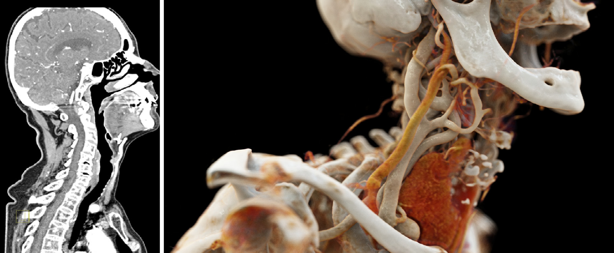
History
Doctors use 2D MRI slices
But we are 3D
Photorealistic images have advantages:
  Object recognition
  Depth perception
  More intuitive
Left: Original CT data. Right: Cinematic rendering of the same dataset.
Comaniciu, D., Engel, K., Georgescu, B., & Mansi, T. (2016). Shaping the future through innovations: From medical imaging to precision medicine. Medical Image Analysis, 33, 19–26. https://doi.org/10.1016/j.media.2016.06.016

Slide 4
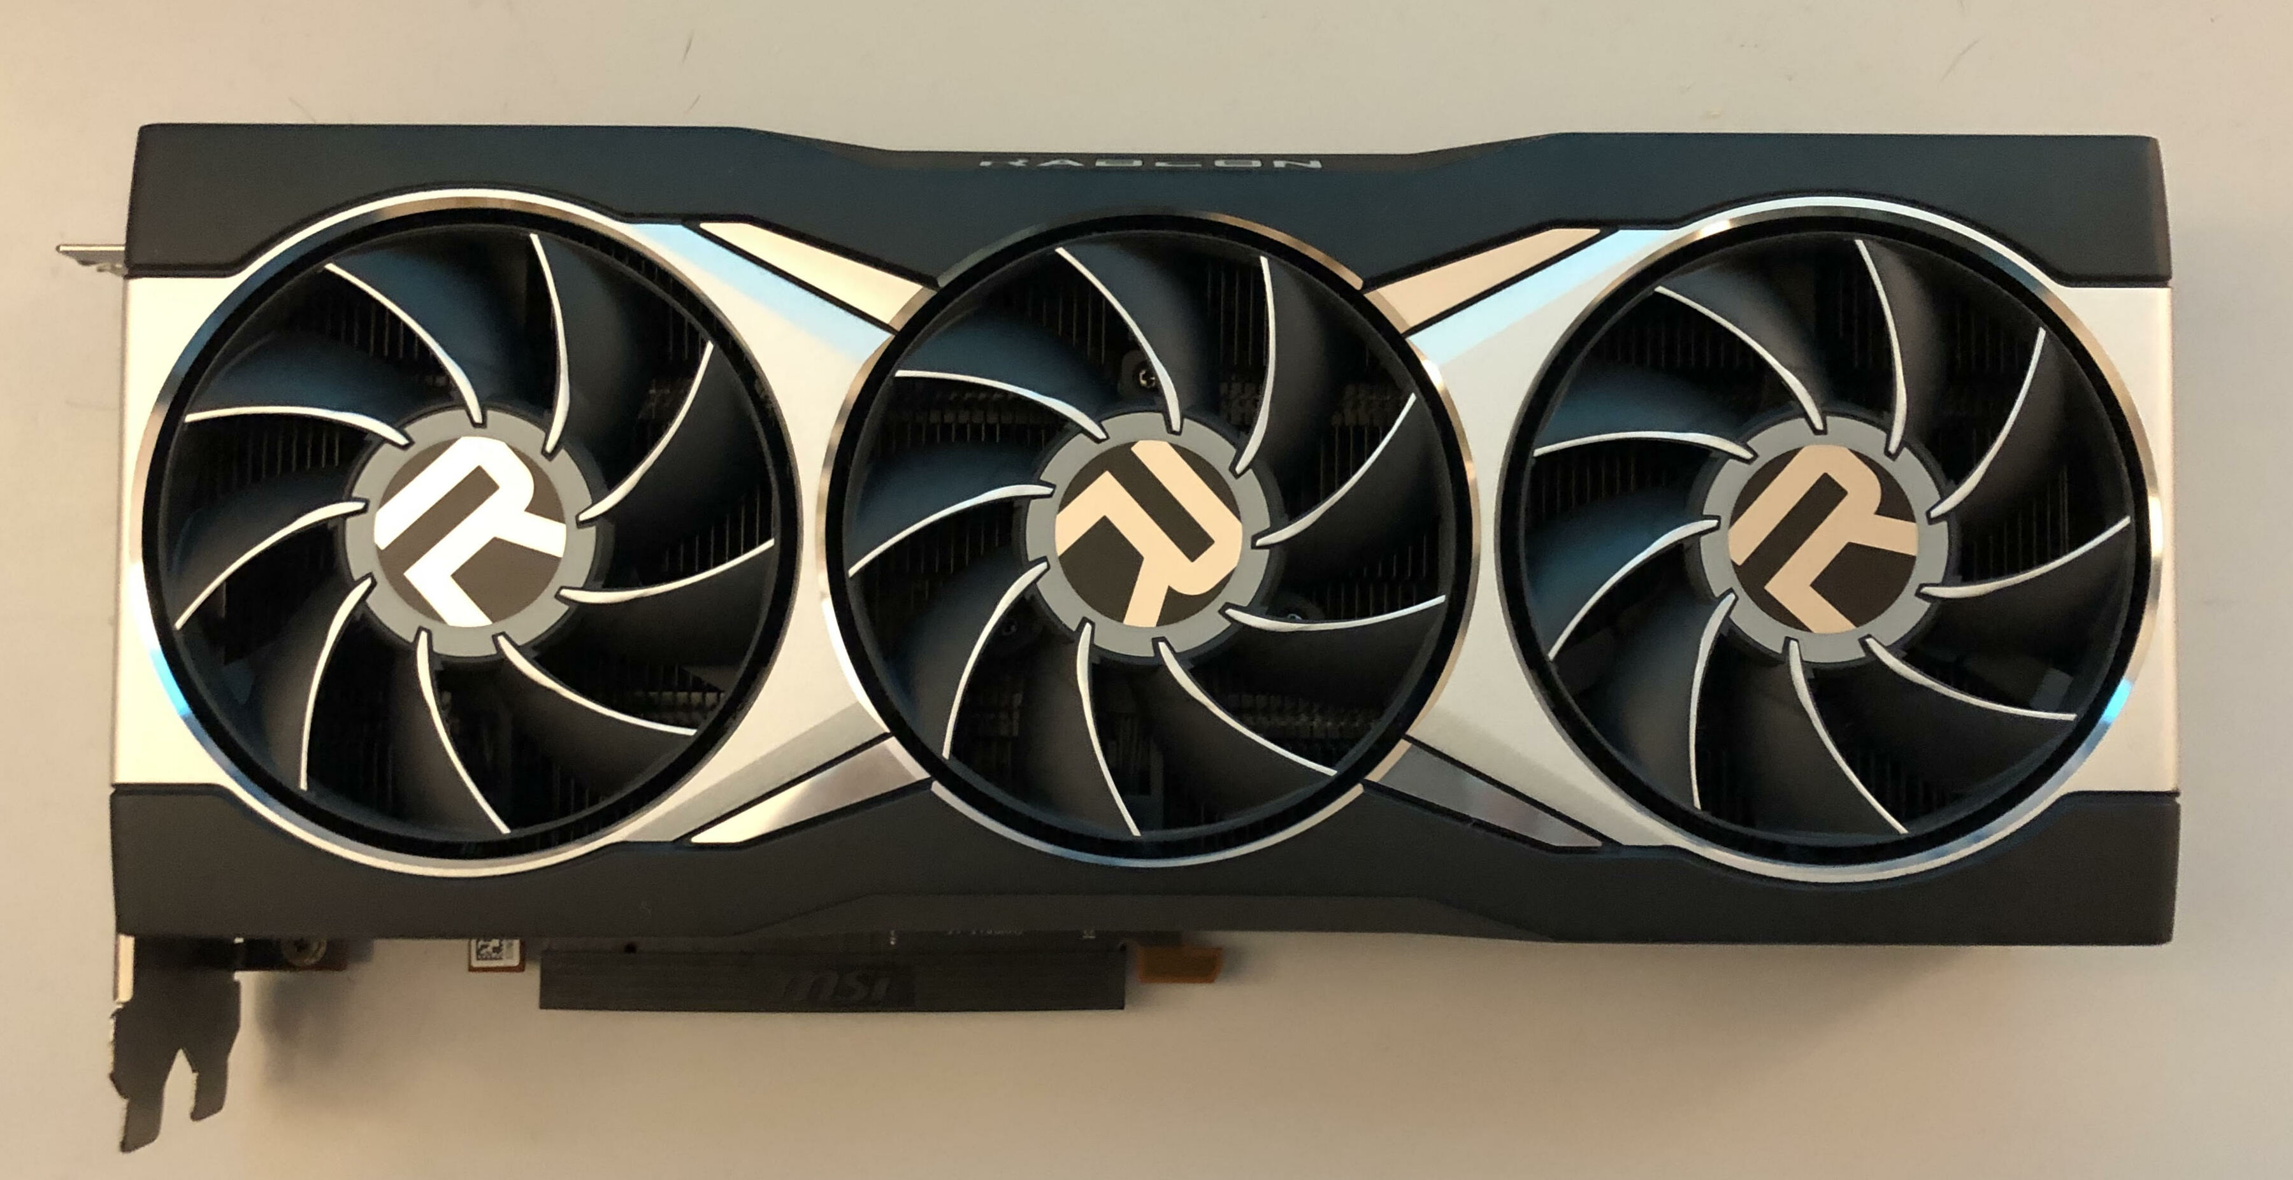
History
Why is 2D the standard?
Has been used for decades
3D also exists for some time
...but not always photorealistic
Only recently are graphics cards powerful
Quality and interactivity warrents research
Verte95. (2021). Deutsch: AMD RX 6900XT Referenzdesign [Graphic]. Own work. https://commons.wikimedia.org/wiki/File:AMD_RX_6900XT_.jpg

Slide 5
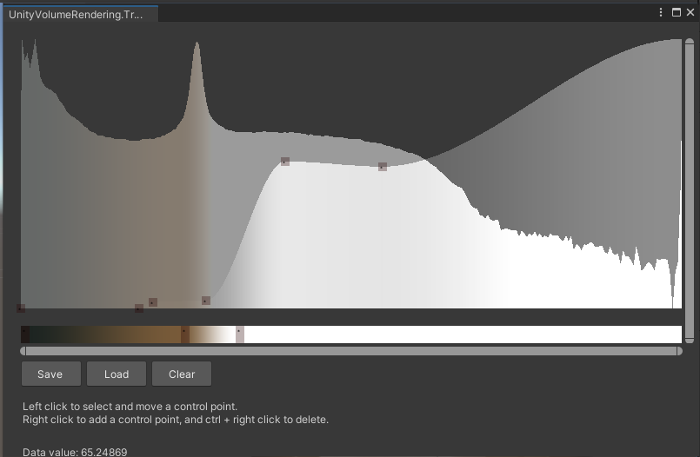
Goal
Investigate feasability
Integrate into Unity
Cross-platform
Import medical file formats
Edit transfer function
Editor-only transfer function window from UnityVolumeRendering
Lavik, M. (2025). Mlavik1/UnityVolumeRendering [C#]. https://github.com/mlavik1/UnityVolumeRendering (Original work published 2019)

Slide 6
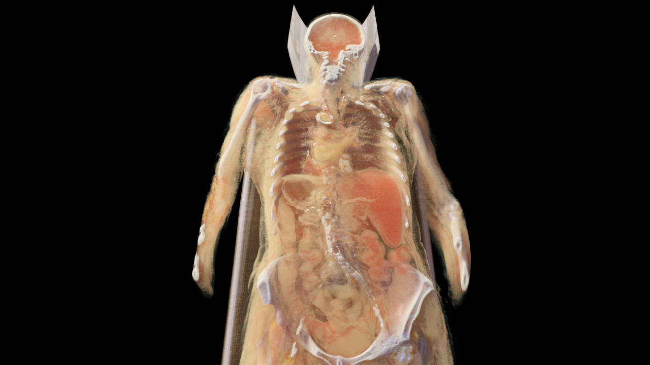
Related Work: VolRen
Volumetric path tracer
Made in OpenGL
Core of thesis
Hofmann, N. (2025). Nihofm/volren [C++]. https://github.com/nihofm/volren (Original work published 2023)

Slide 7
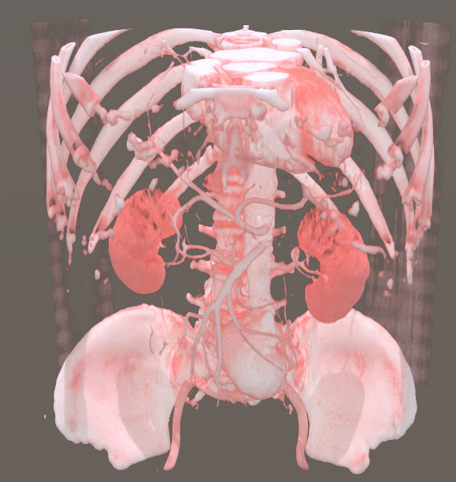
Related Work: Volumetric Path Tracing in Unity
Ported VolRen to Unity
Translated OpenGL to HLSL
Issues remain open
Will be continued
Giesse, S. (n.d.). Volumetric Path Tracing inside the Unity Game Engine.

Slide 8
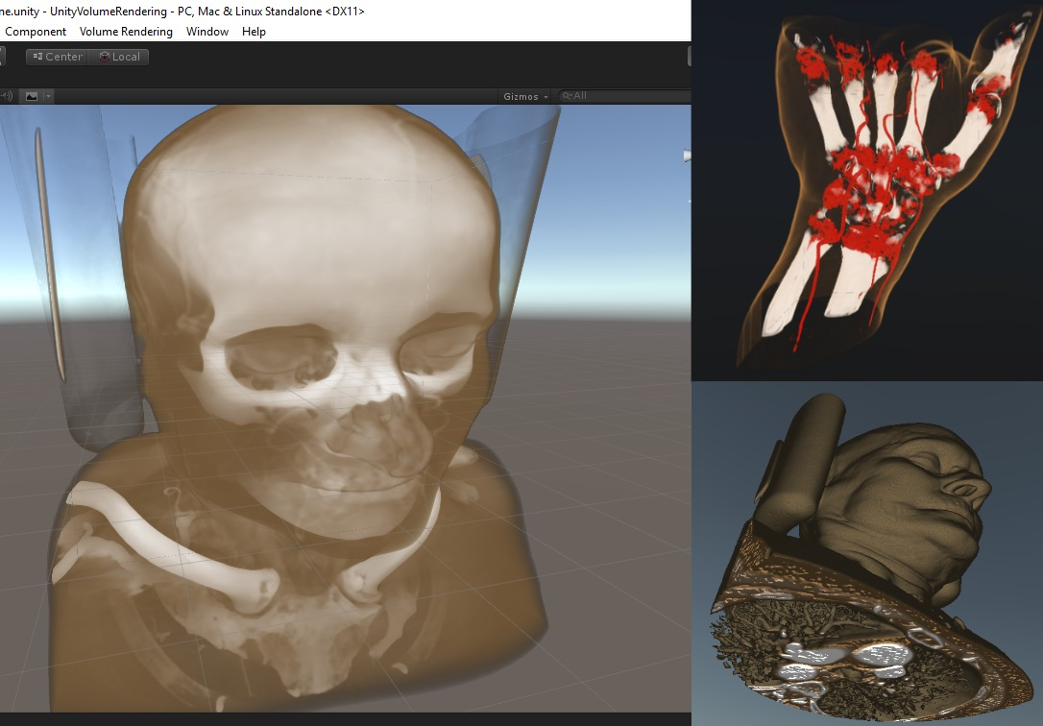
Related Work: UnityVolumeRendering
Ray marching algorithm
Succesfully ported into Unity
DICOM importer
Transfer function editor
Lavik, M. (2025). Mlavik1/UnityVolumeRendering [C#]. https://github.com/mlavik1/UnityVolumeRendering (Original work published 2019)

Slide 9
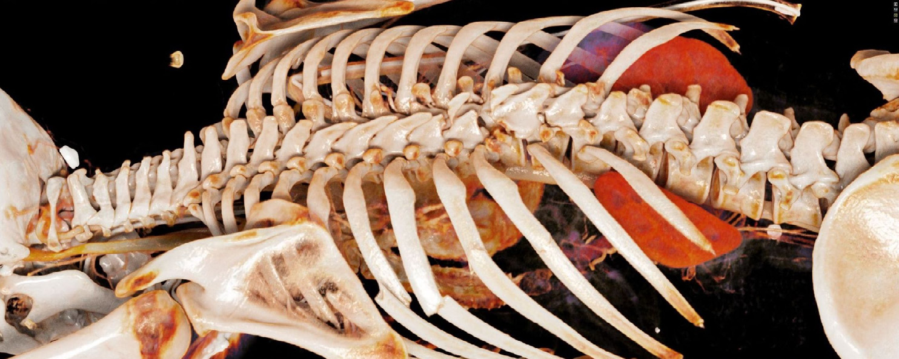
Related Work: Cinematic Rendering
Photorealistic renderer from Siemens
Monte Carlo path tracing
ML to differentiate organs
Minimally invasive live updates
Patient-specific models
Comaniciu, D., Engel, K., Georgescu, B., & Mansi, T. (2016). Shaping the future through innovations: From medical imaging to precision medicine. Medical Image Analysis, 33, 19–26. https://doi.org/10.1016/j.media.2016.06.016

Slide 10
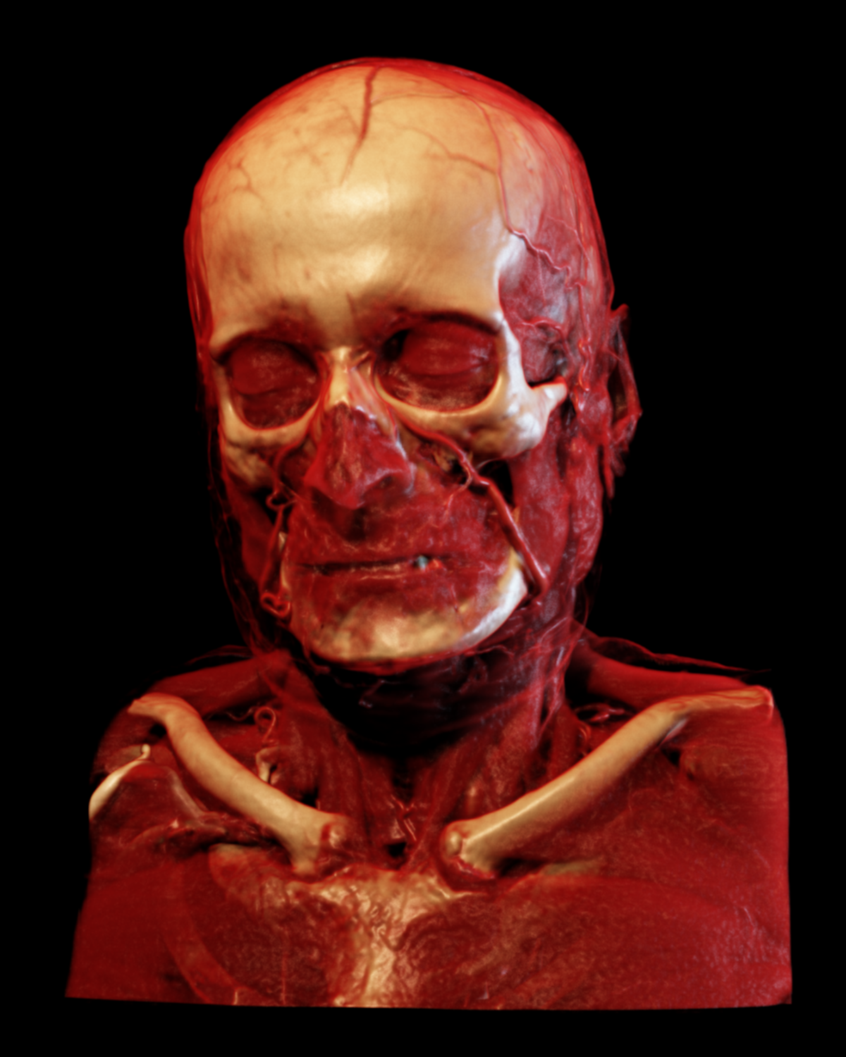
Related Work: Exposure Render
CUDA based
Monte Carlo ray tracing
Renders entire volume
Effects easily implemented
Kroes, T. (2025). ThomasKroes/exposure-render [C++]. https://github.com/ThomasKroes/exposure-render (Original work published 2015)

Slide 11
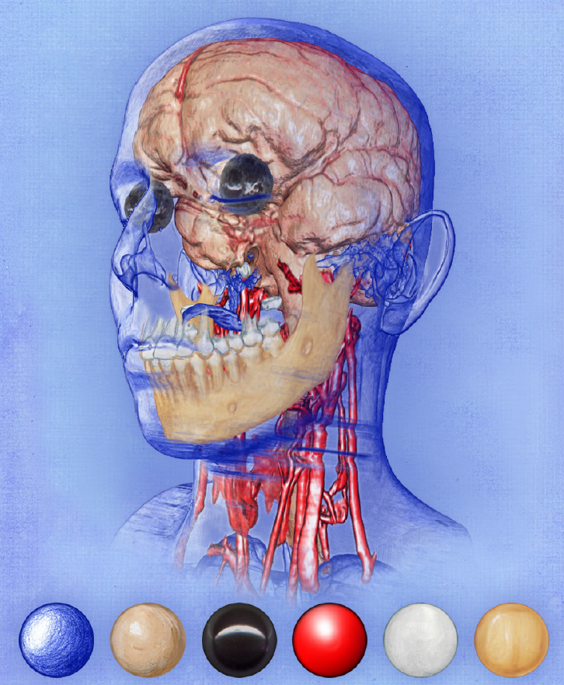
Related Work: Transfer Functions
Map density to color and opacity
Shows current research
Higher dimensional TFs
Animation
Editors
Ljung, P., Krüger, J., Groller, E., Hadwiger, M., Hansen, C. D., & Ynnerman, A. (2016). State of the Art in Transfer Functions for Direct Volume Rendering. Computer Graphics Forum, 35(3), 669–691. https://doi.org/10.1111/cgf.12934

Slide 12

Approach
Build off Giesse's work
Finish porting VolRen
Fix bugs and issues
Add new effects
Optimize
Compare and benchmark
Halfwitty. (2020). English: This is a beaker from a science lab [Graphic]. Own work. https://commons.wikimedia.org/wiki/File:Beaker_for_Lab.png

Slide 13

Time Plan
Complete integration into Unity: 4 weeks
DICOM importer: 1 week
Transfer function editor: 1 week
More rendering features: 2 weeks
Optimize: 1 week
Benchmark: 1 week
Writing and documentation: 3 weeks
Bug fixing: 1 week
Buffer time: 2 weeks
Kainz, A., Herrera, U., Lake, A., Martin, M., Sitter, H., Riddell, J., Vermette, K., Pol, A., Faure, D., Vaca, A., Beltrame, L., Popov, G., Pinheiro, N., Richardson, A., Grulich, J., Landauer, B., Becker, H., Krause, V., Rosca, D., & Schaf, P. (2014). English: Breeze 5.22.0 (from the “Actions” group) icons of KDE 5 [Graphic]. https://github.com/KDE/breeze-icons https://github.com/KDE/breeze-icons/releases/tag/v5.22.0. https://commons.wikimedia.org/wiki/File:Breezeicons-actions-22-view-calendar-timeline.svg

Slide 14
Questions?

Slide 15
Thank you for listening!

